Slide 1
Case Study 2: ATAC-seq x RNA-seq
Johnathan Lo, 2020

Slide 2
Data description
1 set of scRNA-seq data, 1 set of ATAC-seq data
1047 observations each, 12407 shared features
Cells are in perfect correspondence with one another! (e.g. cell 1 in the scRNA-seq dataset is the SAME cell as cell 1 from the ATAC-seq dataset

Slide 3
Experimental design
Divided into two groups: one using standard preprocessing (pp) procedure, one without preprocessing (npp)
Treatments: no integration (controls), Harmony, UnionCom, MMD-ResNet
UnionCom could not run on npp dataset because of memory restrictions
Evaluations:
visual – PCA, t-SNE, UMAP
Quantitative – ARI, ASW, LISI, kBET

Slide 4
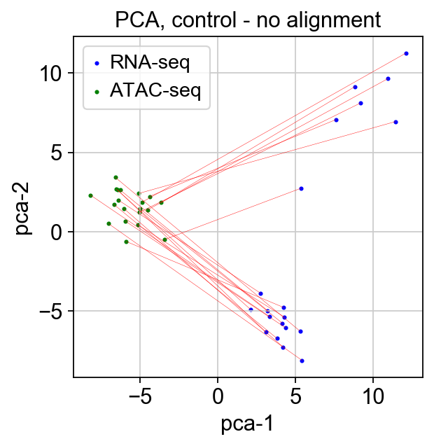
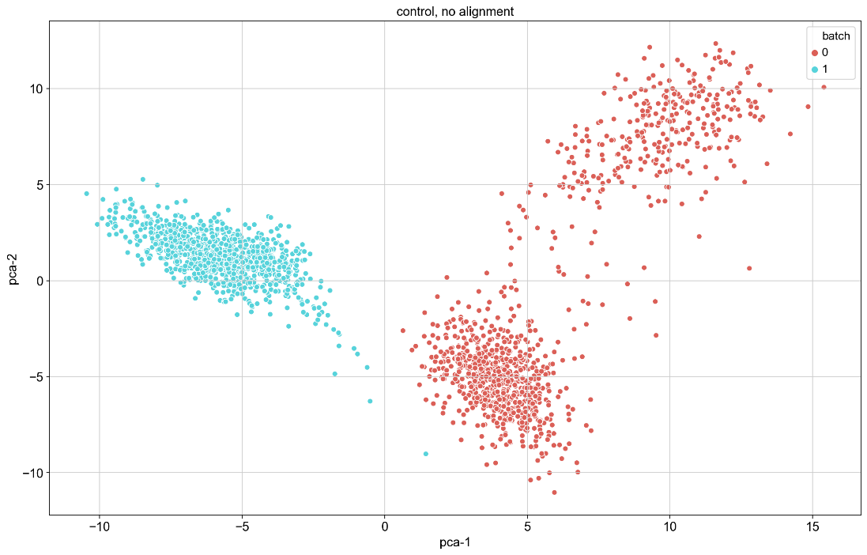
Results: Controls
PCA – with preprocessing (pp)
Right: lines connecting identical observations (sample of 20: see folder for full plot)
Bottom: 2D visualization

Slide 5
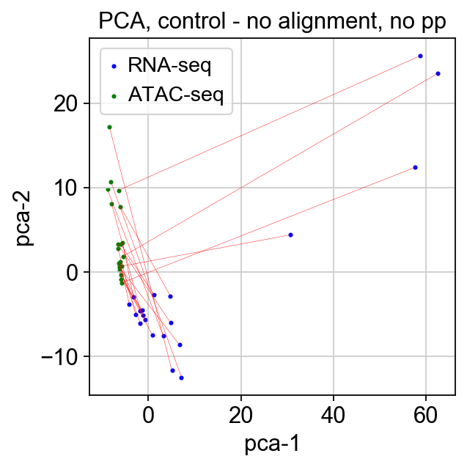
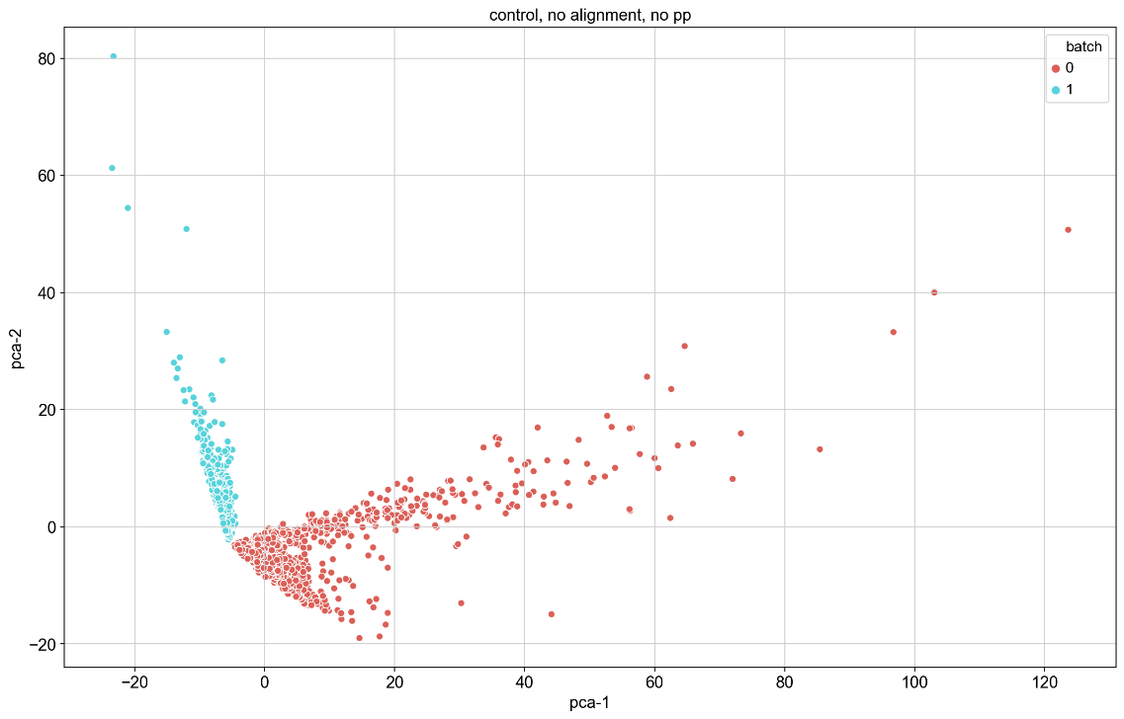
Results: Controls
PCA – without preprocessing (pp)
Right: lines connecting identical observations (sample of 20: see folder for full plot)
Bottom: 2D visualization

Slide 6
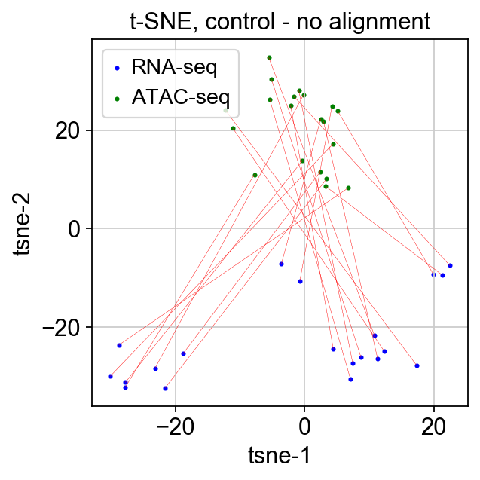
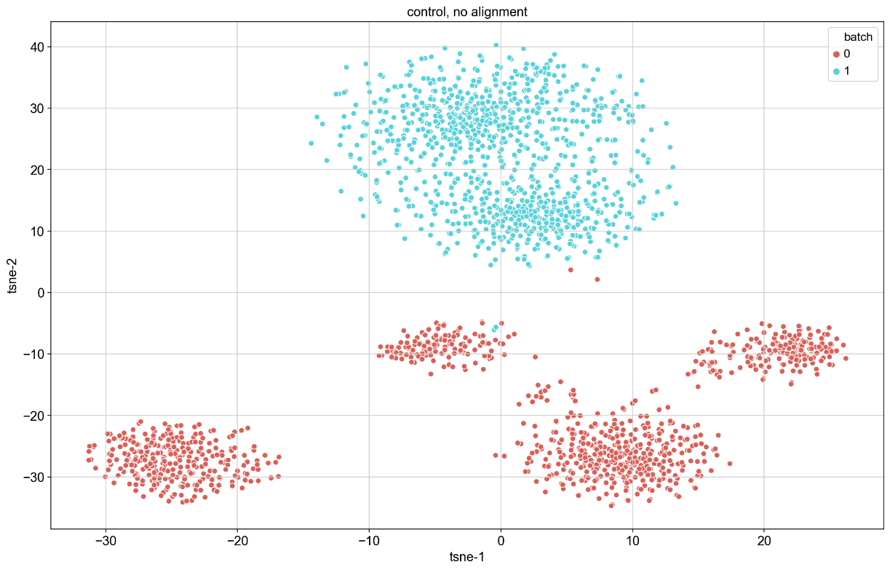
Results: Controls
t-SNE – with preprocessing (pp)
Right: lines connecting identical observations (sample of 20: see folder for full plot)
Bottom: 2D visualization

Slide 7
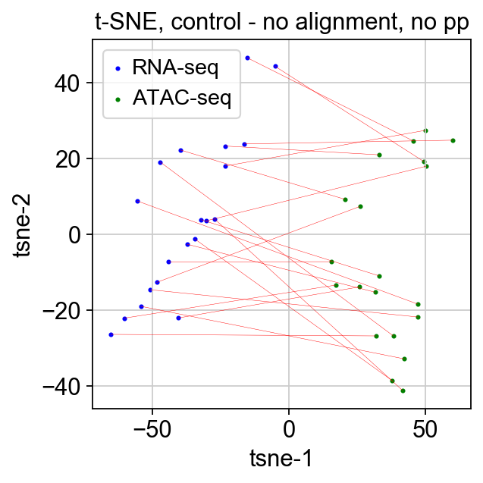
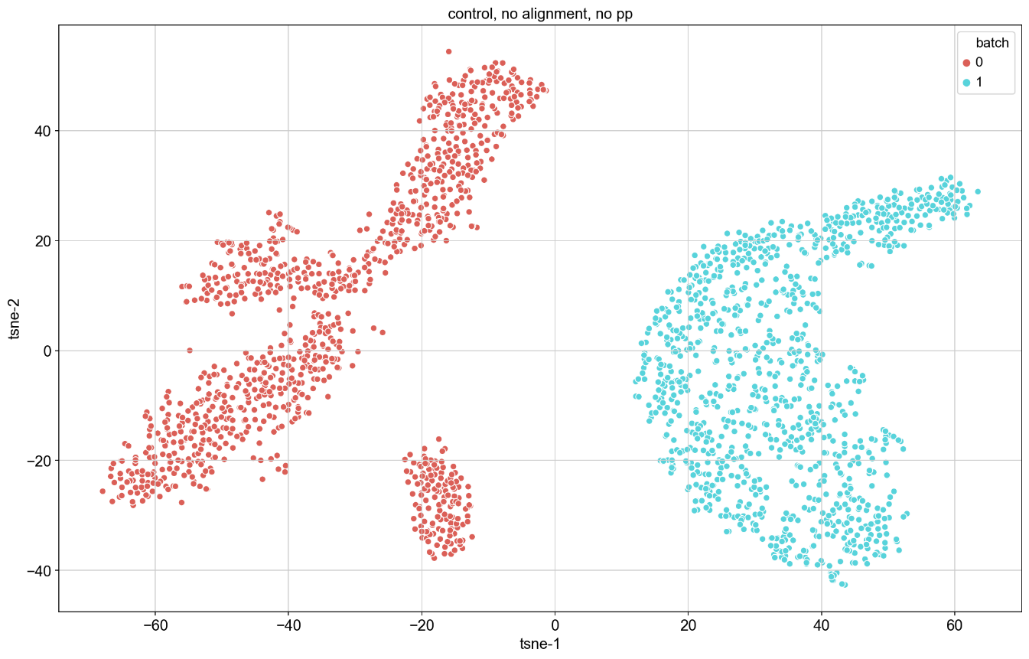
Results: Controls
t-SNE – without preprocessing (pp)
Right: lines connecting identical observations (sample of 20: see folder for full plot)
Bottom: 2D visualization

Slide 8
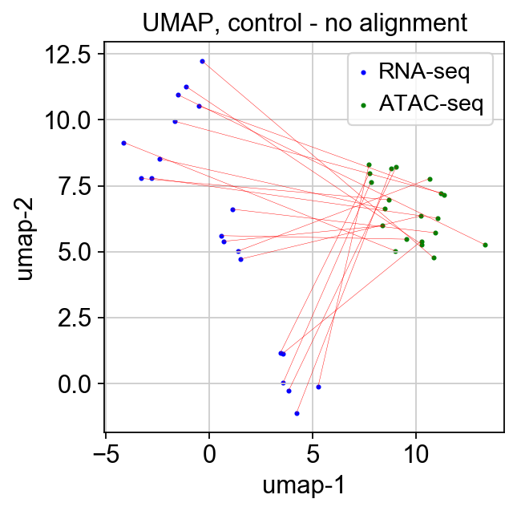
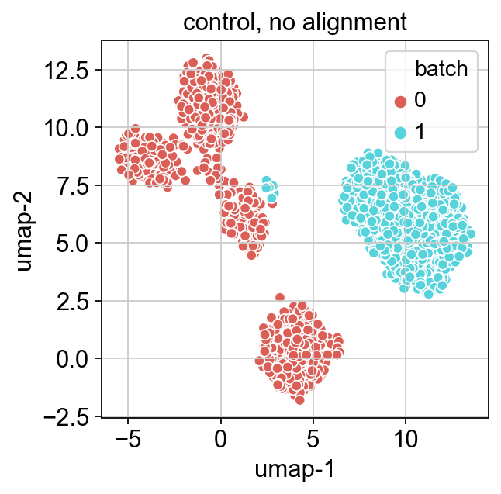
Results: Controls
UMAP – with preprocessing (pp)
Right: lines connecting identical observations (sample of 20: see folder for full plot)
Bottom: 2D visualization

Slide 9
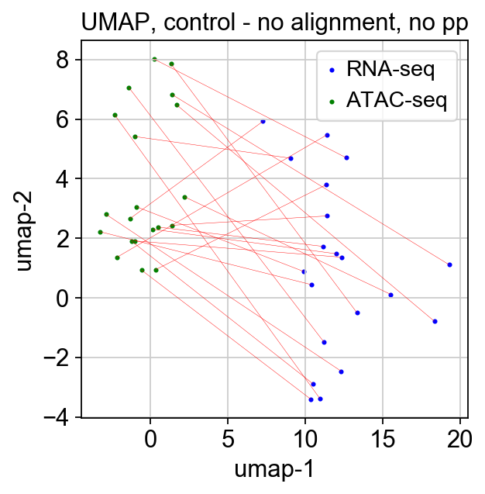
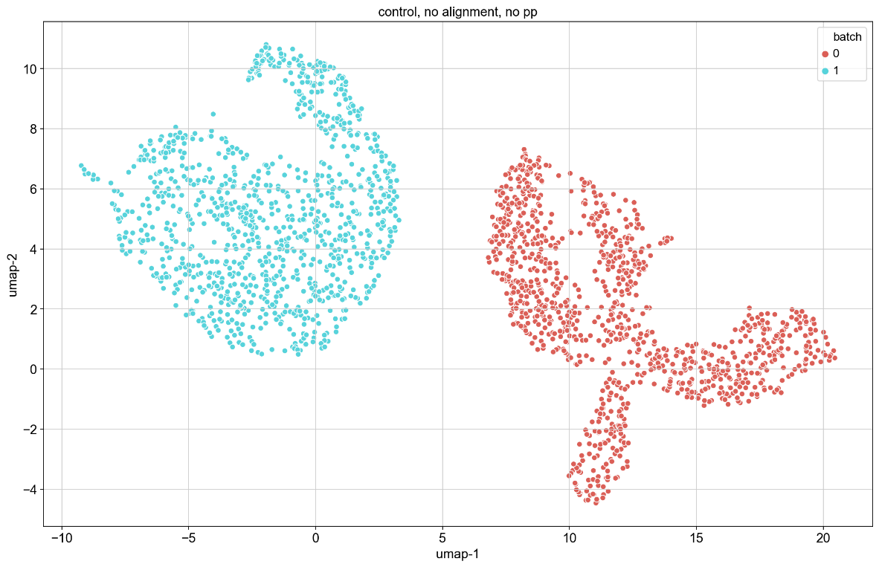
Results: Controls
UMAP – without preprocessing (pp)
Right: lines connecting identical observations (sample of 20: see folder for full plot)
Bottom: 2D visualization

Slide 10
Results: Controls
UMAP – with preprocessing (pp)
Right: lines connecting identical observations (sample of 20: see folder for full plot)
Bottom: 2D visualization

Slide 11
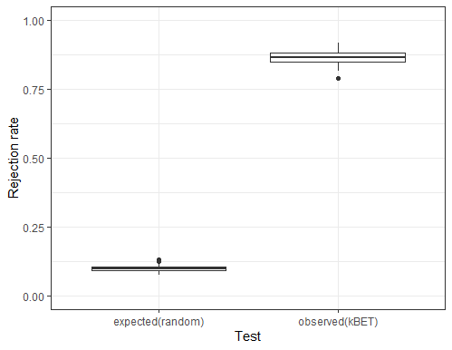
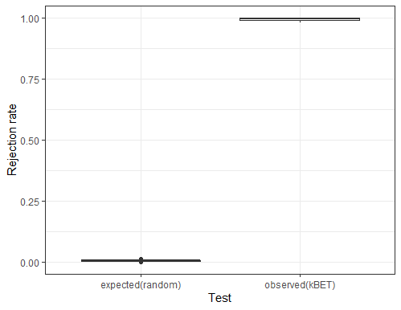
Results: Controls
kBET
Right: pp
Bottom: npp

Slide 12
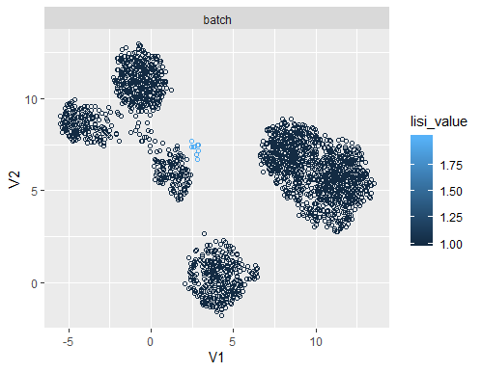
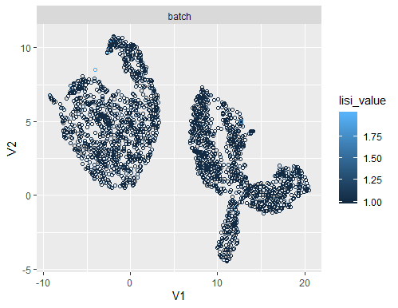
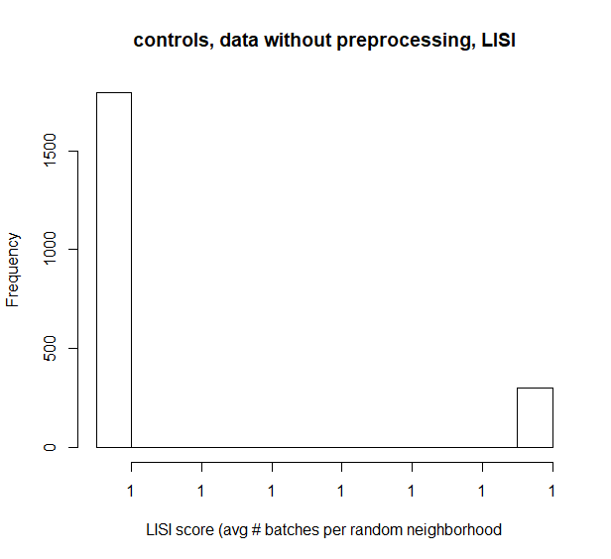
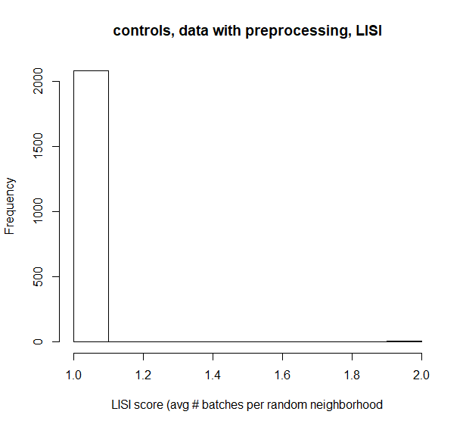
Results: Controls
LISI
Right: pp
Bottom: npp

Slide 13
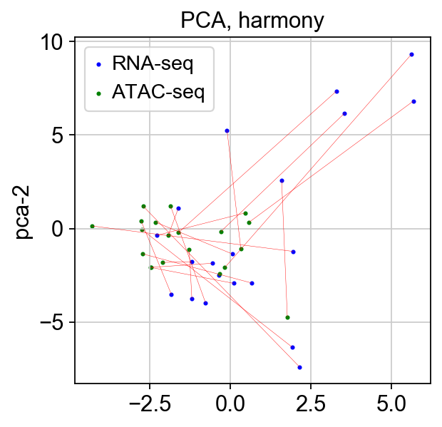
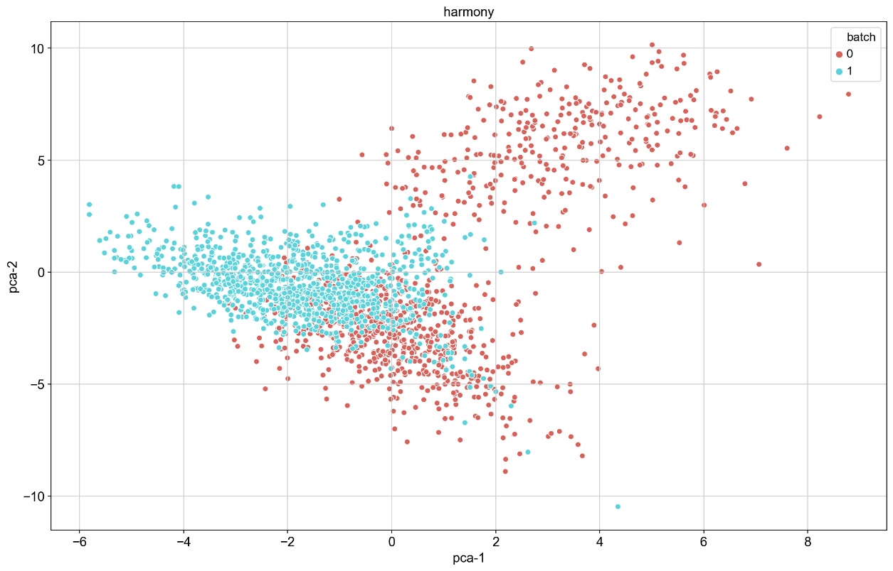
Results: Harmony
PCA – with preprocessing (pp)
Right: lines connecting identical observations (sample of 20: see folder for full plot)
Bottom: 2D visualization

Slide 14
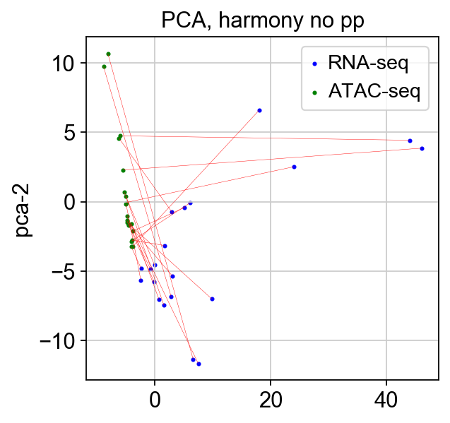
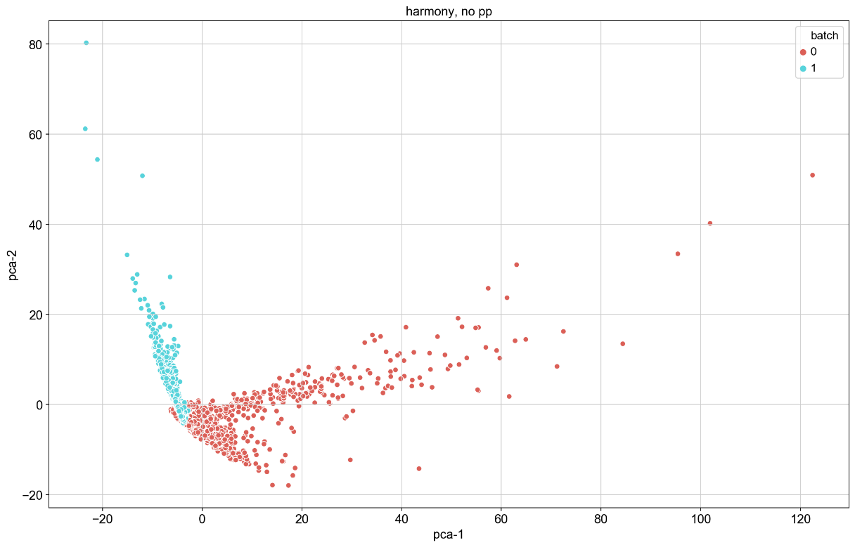
Results: Harmony
PCA – without preprocessing (pp)
Right: lines connecting identical observations (sample of 20: see folder for full plot)
Bottom: 2D visualization

Slide 15
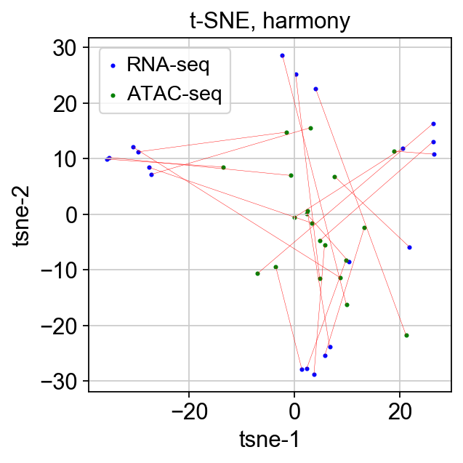
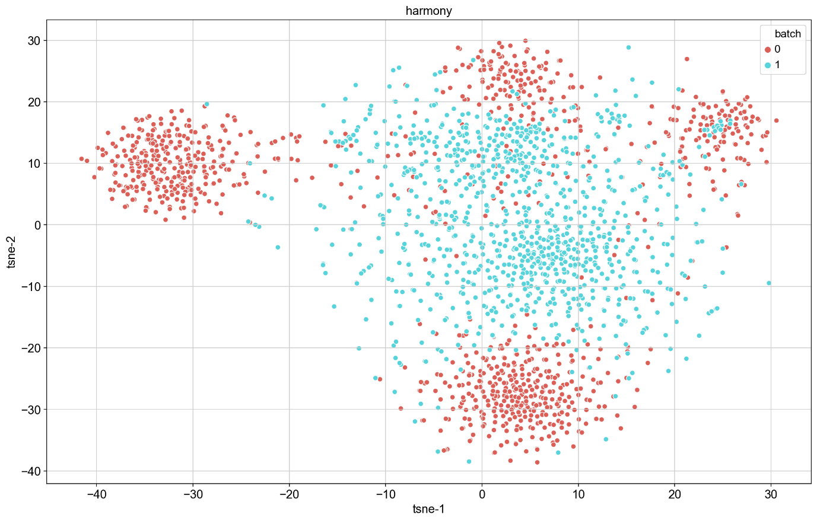
Results: Harmony
t-SNE – with preprocessing (pp)
Right: lines connecting identical observations (sample of 20: see folder for full plot)
Bottom: 2D visualization

Slide 16
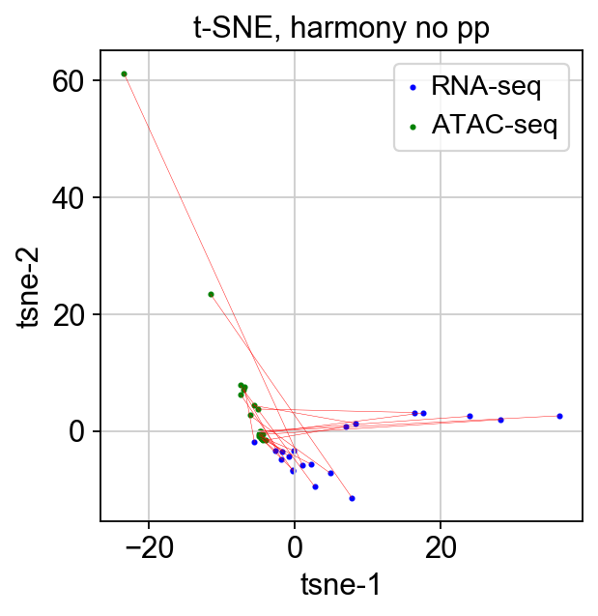
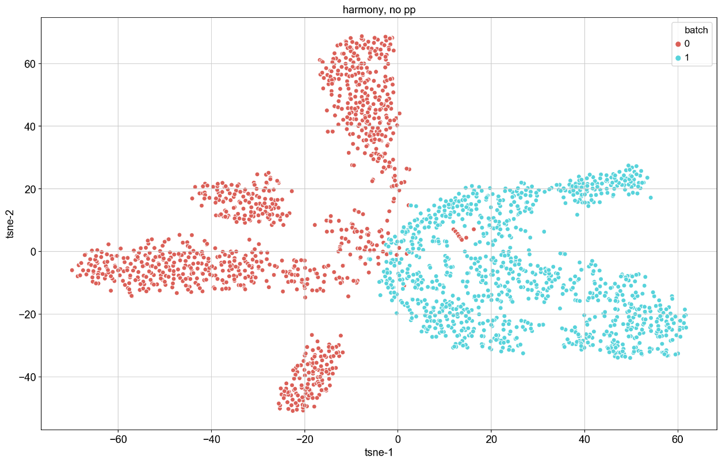
Results: Harmony
t-SNE – without preprocessing (pp)
Right: lines connecting identical observations (sample of 20: see folder for full plot)
Bottom: 2D visualization

Slide 17
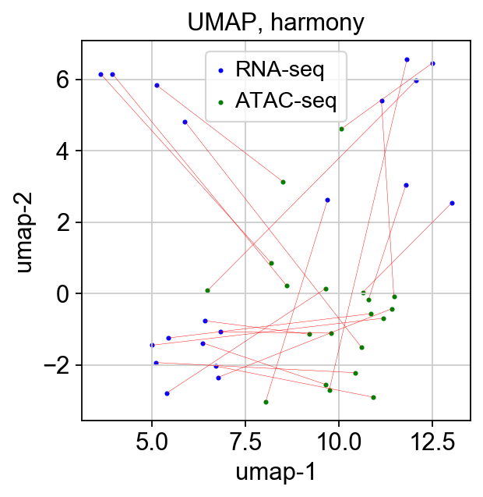
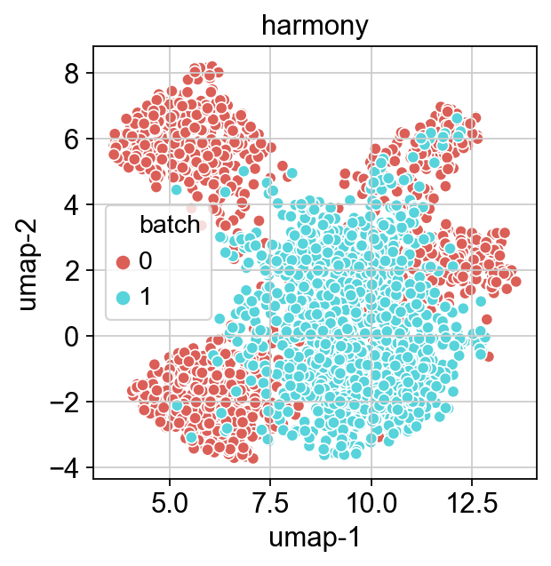
Results: Harmony
UMAP – with preprocessing (pp)
Right: lines connecting identical observations (sample of 20: see folder for full plot)
Bottom: 2D visualization

Slide 18
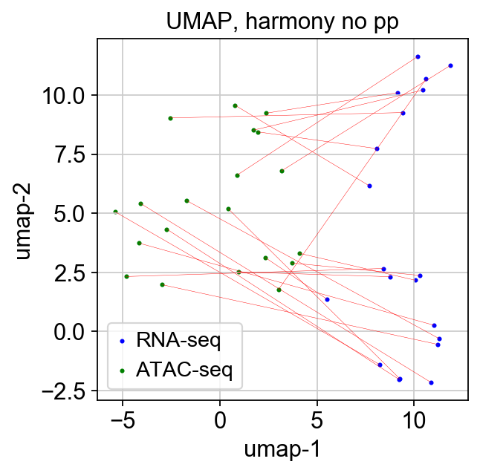
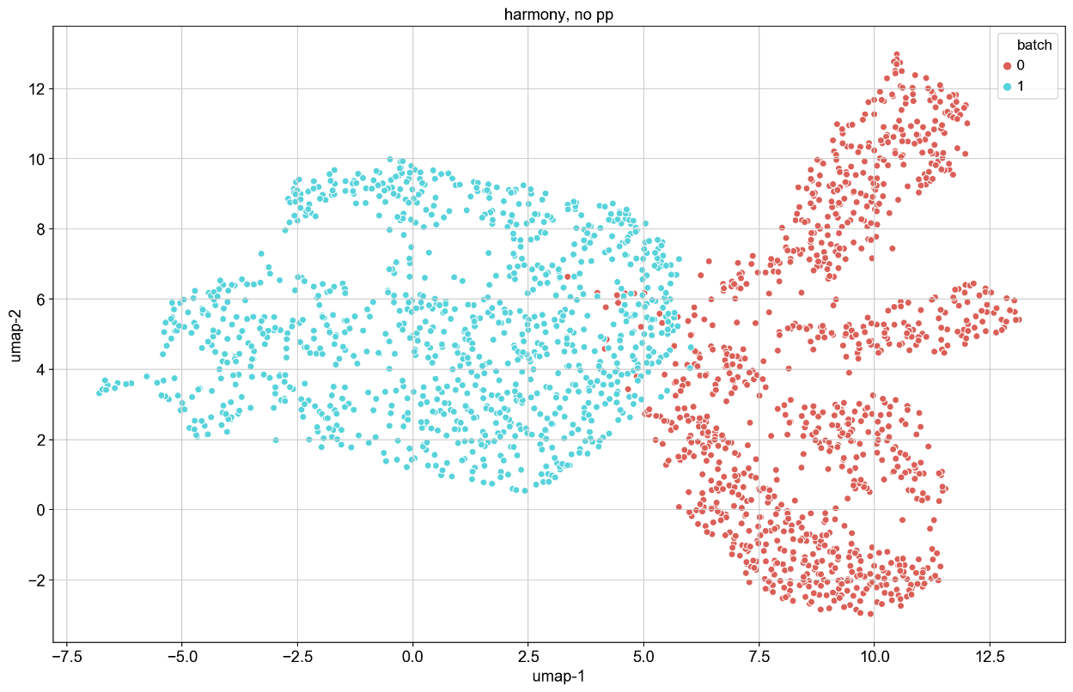
Results: Harmony
UMAP – without preprocessing (pp)
Right: lines connecting identical observations (sample of 20: see folder for full plot)
Bottom: 2D visualization

Slide 19
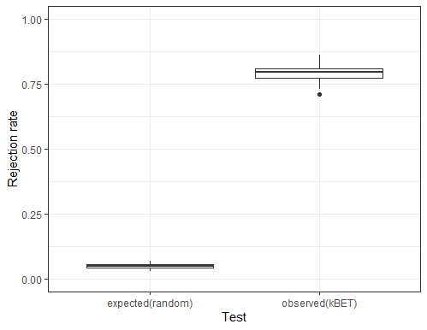
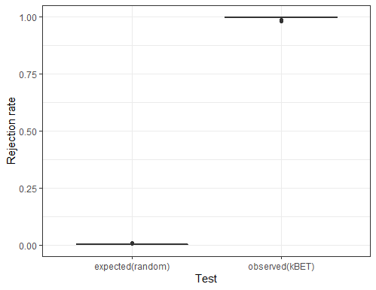
Results: Harmony
kBET
Right: pp
Bottom: npp

Slide 20
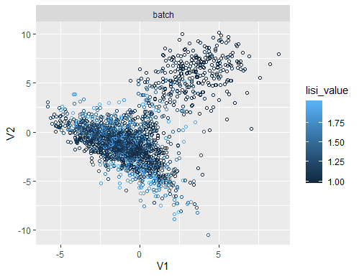
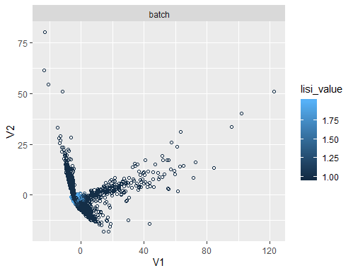
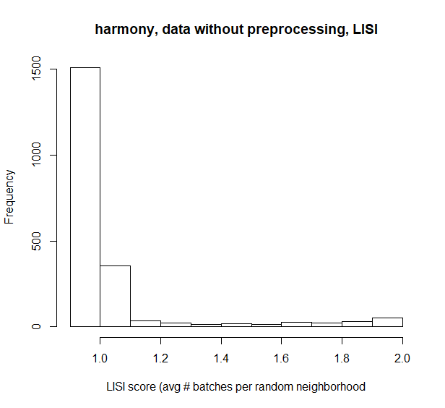
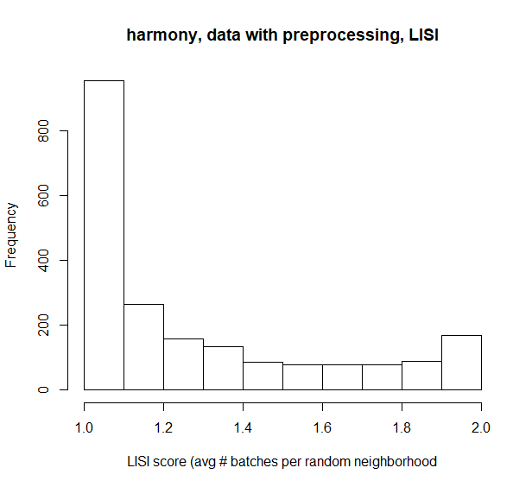
Results: Harmony
LISI
Right: pp
Bottom: npp

Slide 21
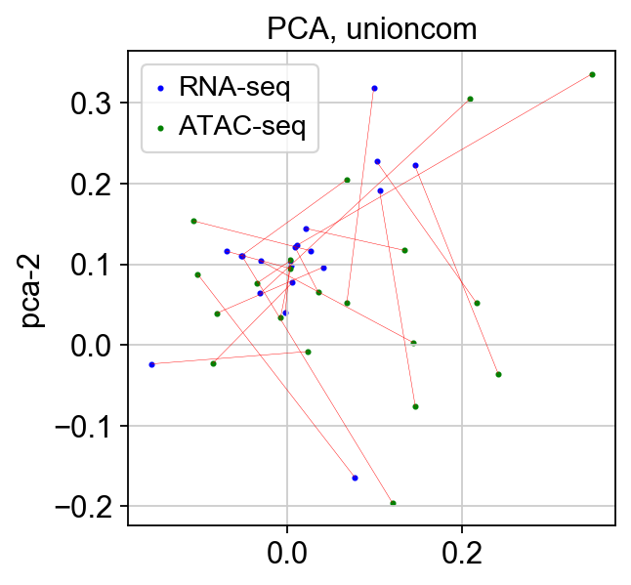
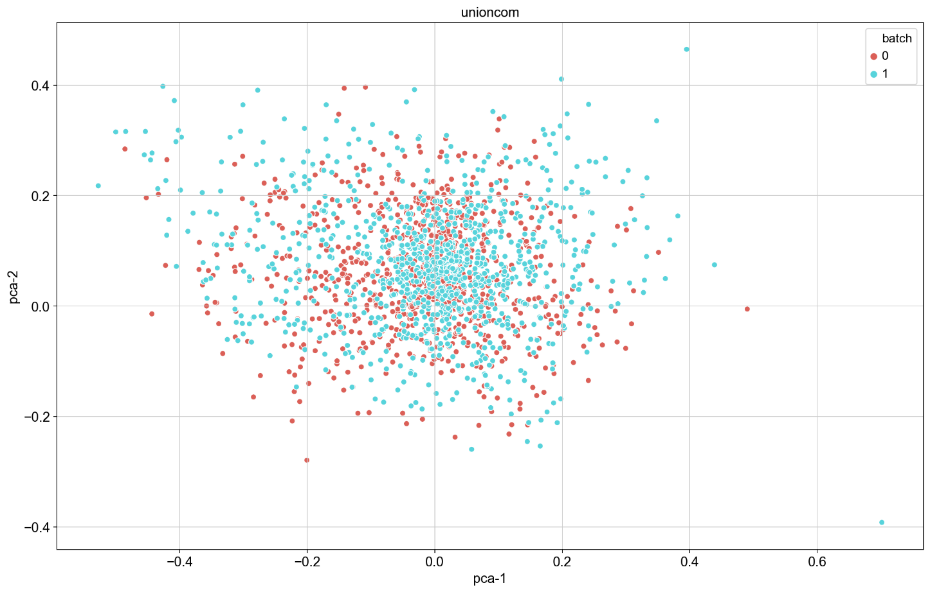
Results: UnionCom
PCA – with preprocessing (pp)
Right: lines connecting identical observations (sample of 20: see folder for full plot)
Bottom: 2D visualization

Slide 22
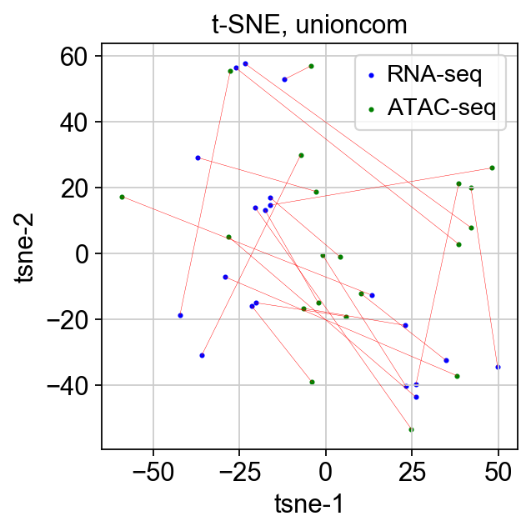
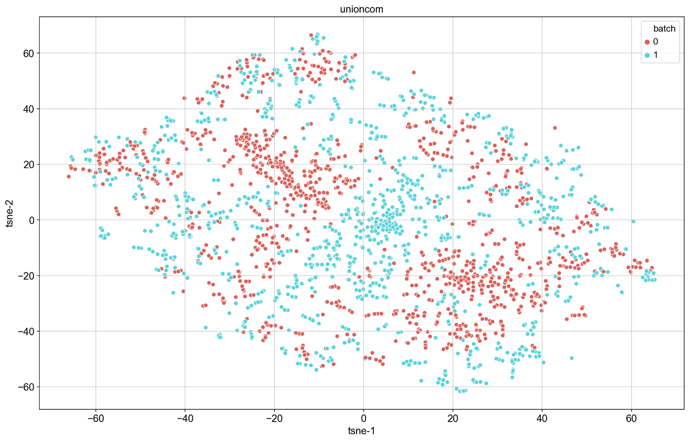
Results: UnionCom
t-SNE – with preprocessing (pp)
Right: lines connecting identical observations (sample of 20: see folder for full plot)
Bottom: 2D visualization

Slide 23
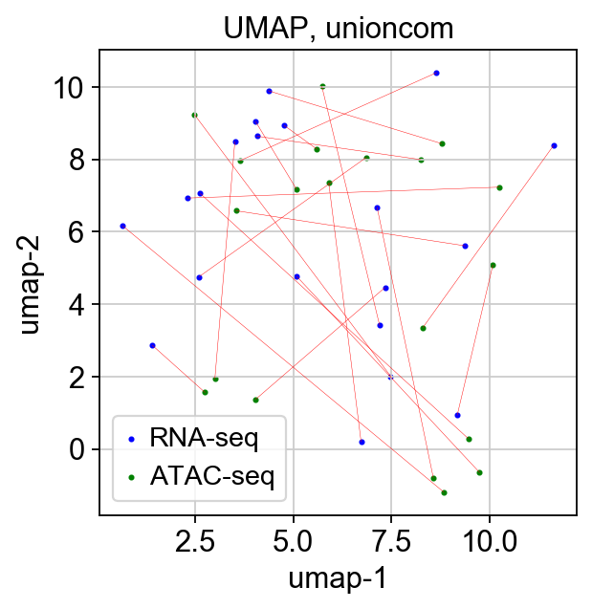
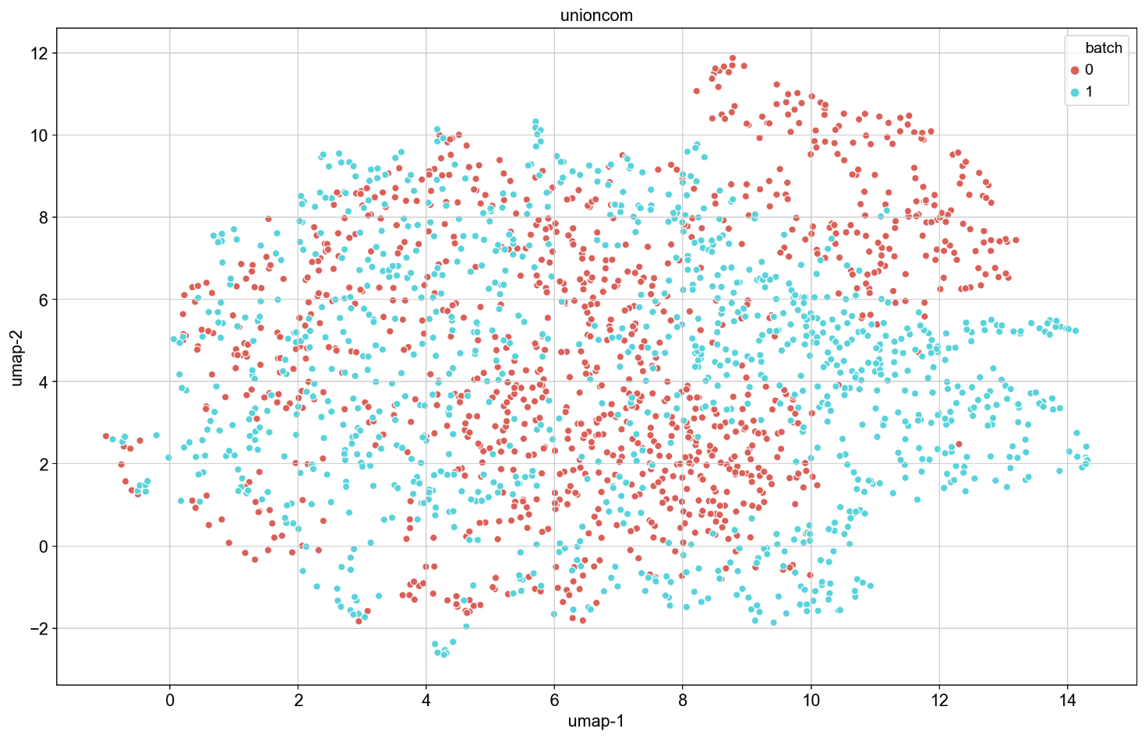
Results: UnionCom
UMAP – with preprocessing (pp)
Right: lines connecting identical observations (sample of 20: see folder for full plot)
Bottom: 2D visualization

Slide 24
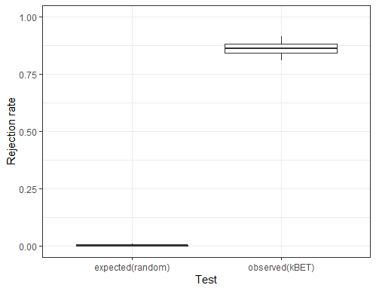
Results: UnionCom
kBET

Slide 25
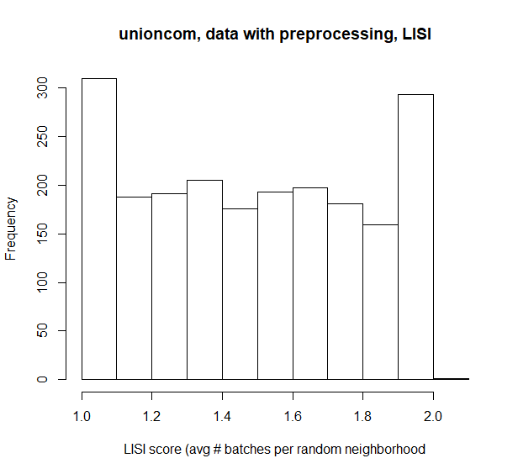
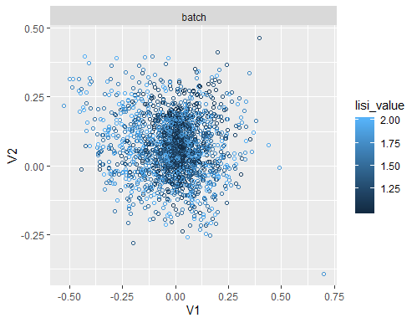
Results: UnionCom
LISI

Slide 26
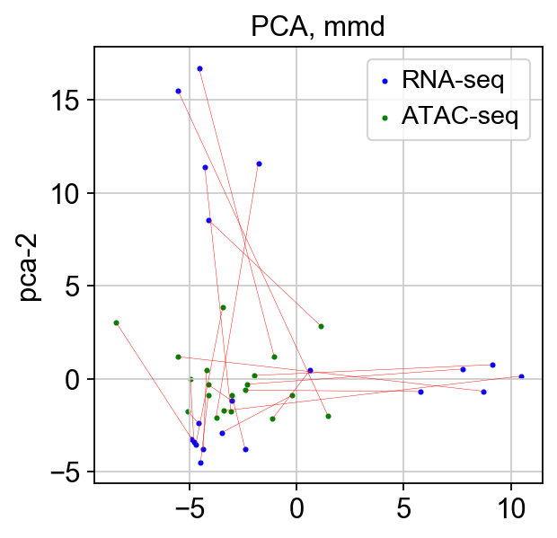
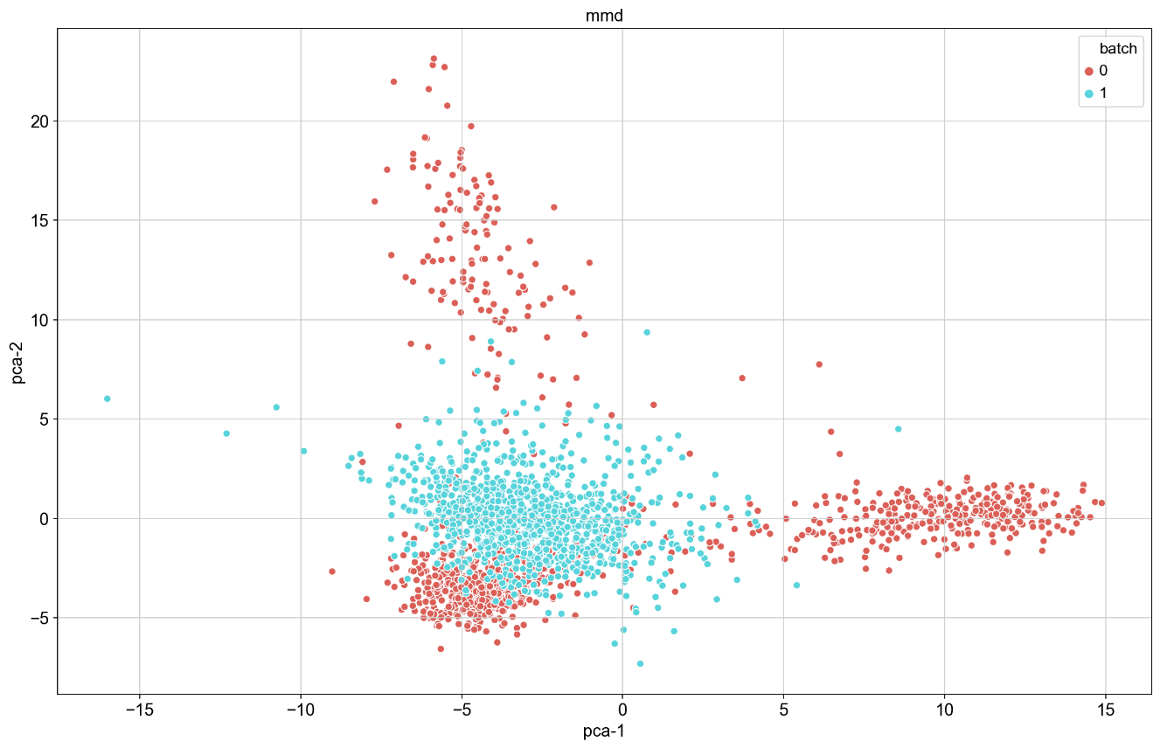
Results: MMD-ResNet
PCA – with preprocessing (pp)
Right: lines connecting identical observations (sample of 20: see folder for full plot)
Bottom: 2D visualization

Slide 27
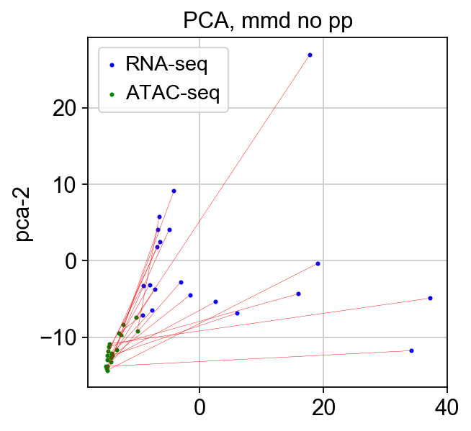
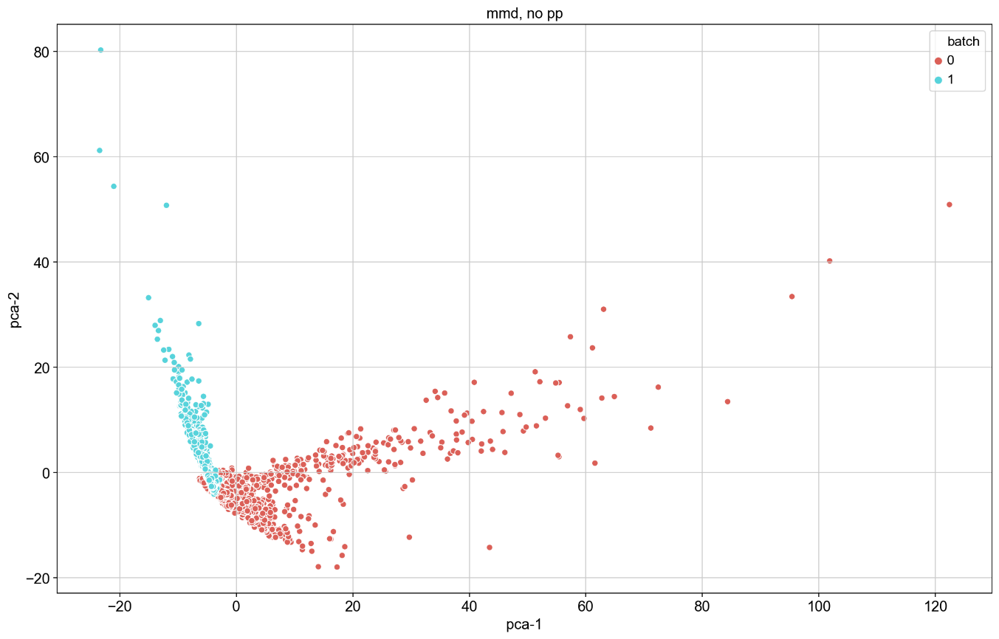
Results: MMD-ResNet
PCA – without preprocessing (pp)
Right: lines connecting identical observations (sample of 20: see folder for full plot)
Bottom: 2D visualization

Slide 28
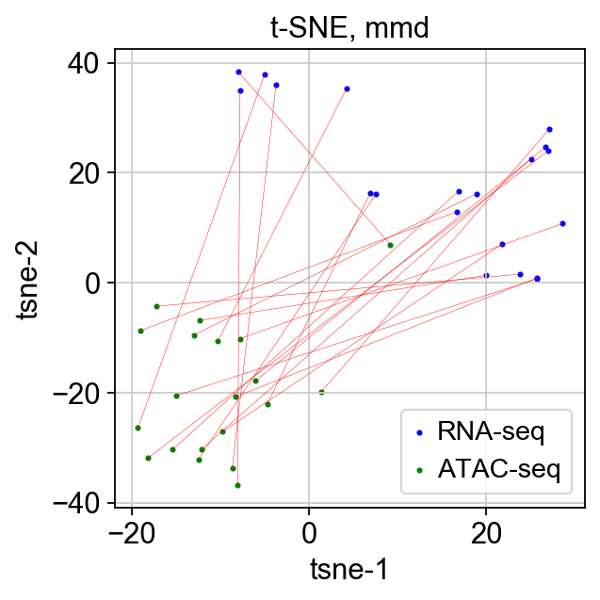

Results: MMD-ResNet
t-SNE – with preprocessing (pp)
Right: lines connecting identical observations (sample of 20: see folder for full plot)
Bottom: 2D visualization

Slide 29


Results: MMD-ResNet
t-SNE – without preprocessing (pp)
Right: lines connecting identical observations (sample of 20: see folder for full plot)
Bottom: 2D visualization

Slide 30


Results: MMD-ResNet
UMAP – with preprocessing (pp)
Right: lines connecting identical observations (sample of 20: see folder for full plot)
Bottom: 2D visualization

Slide 31


Results: MMD-ResNet
UMAP – without preprocessing (pp)
Right: lines connecting identical observations (sample of 20: see folder for full plot)
Bottom: 2D visualization

Slide 32


Results: MMD-ResNet
kBET
Right: pp
Bottom: npp

Slide 33




Results: MMD-ResNet
LISI
Right: pp
Bottom: npp

Slide 34
ASW and ARI

